Slide 1
All-or-Nothing Atomicity
An action is atomic
  if there is no way for a higher layer to discover the internal structure of its implementation
<> From the point of view of a procedure that invokes an atomic action
  The atomic action always appears either to complete as anticipated, or to do nothing
  atomic actions useful in recovering from failures

Slide 2
Before-or-After Atomicity
<> From the point of view of a concurrent thread
  An atomic action acts as though it occurs either completely before or completely after every other concurrent atomic action
  This consequence: makes atomic actions useful for coordinating concurrent threads
Atomicity hides
  not just the details of which steps form the atomic action
  But the very fact that it has structure

Slide 3
All-or-Nothing and Before-or-After Atomicity
1. Data abstraction
  Hide the internal structure of data
2. Client/server organization
  Hide the internal structure of major subsystems
3. Atomicity
  Hide the internal structure of an action
Enforce industrial-strength modularity
  Guarantee absence of unanticipated interactions among components of a complex system
The implementer’s point of view
  Painfully knowing the detail

Slide 4
Atomic actions’ benevolent side effects
audit log
  atomic actions that run into trouble record
    the nature of the detected failure and
    the recovery sequence
  for later analysis
Data management system when insert a record
  rearrange the file into a better physical order
Cache
Garbage collection
They are all hidden from upper levels

Slide 5
Overall system fault tolerance model
error-free operation不会出错的(不存在的):
  All work goes according to expectations
  The user initiates actions and the system confirms the actions by displaying messages to the user
tolerated error（可容忍错误）:
  The user who has initiated an action notices that the system failed before it confirmed completion of the action
  when the system is operating again, checks to see whether or not it actually performed that action
Notes:
tolerated error：如果针对一个bit的错误进行奇偶校验，可以检查到错误，并且恢复

Slide 6
Overall system fault tolerance model
untolerated error（不可容忍的错误）:
  The system fails without the user noticing
  the user does not realize that he or she should check or retry an action that the system may not have completed

Slide 7
Disk Storage System Fault Tolerance Model
A perfect-disk assumption—通常假设磁盘是不会把数据记录错的
  a disk never decays and that it has no hard errors
  only one thing can go wrong: a system crash at just the wrong time

Slide 8
Disk Storage System Fault Tolerance Model
The fault tolerance model
  error-free operation:
    CAREFUL_GET returns the result of the most recent call to CAREFUL_PUT
    at sector_number on track, with status = OK.
  detectable error:
    The operating system crashes during a CAREFUL_PUT
    and corrupts the disk buffer in volatile storage
    and CAREFUL_PUT writes corrupted data on one sector of the disk.

Slide 9
ALL_OR_NOTHING_PUT
假设只有一次出错
procedure ALMOST_ALL_OR_NOTHING_PUT (data, all_or_nothing_sector)
CAREFUL_PUT(data, all_or_nothing_sector.S1)
CAREFUL_PUT (data, all_or_nothing_sector.S2) //commit point
CAREFUL_PUT (data, all_or_nothing_sector.S3)
procedure ALL_OR_NOTHING_GET (reference date,all_or_nothing_sector)
CAREFUL_GET (data1, all_or_nothing_sector.S1)
CAREFUL_GET (data2, all_or_nothing_sector.S2)
CAREFUL_GET (data3, all_or_nothing_sector.S3)
if (data1 = data2) data ← data1
else data ← data3
Notes:
Why “Almost”?
- Not repair previous damage

Slide 10
ALL_OR_NOTHING_PUT
procedure ALL_OR_NOTHING_PUT (data, all_or_nothing_sector)
CHECK_AND_REPAIR (all_or_nothing_sector)
ALMOST_ALL_OR_NOTHING_PUT (data, all_or_nothing_sector)
procedure CHECK_AND_REPAIR (all_or_nothing_sector) // Ensure copies match
CAREFUL_GET (data1, all_or_nothing_sector.S1)
CAREFUL_GET (data2, all_or_nothing_sector.S2)
CAREFUL_GET (data3, all_or_nothing_sector.S3)
Notes:
Check and repair就是将可能出现中间三个磁盘不一致的时候将题目刷成一致的数据。

Slide 11
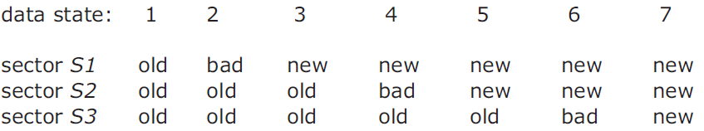
ALL_OR_NOTHING_PUT
if (data1 = data2) and (data2 = data3) return // State 1 or 7, no repair
if (data1 = data2)
CAREFUL_PUT (data1, all_or_nothing_sector.S3) return // State 5 or 6.
if (data2 = data3)
CAREFUL_PUT (data2, all_or_nothing_sector.S1) return // State 2 or 3.
CAREFUL_PUT (data1, all_or_nothing_sector.S2) // State 4, go to state 5
CAREFUL_PUT (data1, all_or_nothing_sector.S3 // State 5, go to state 7
Notes:
提交点是4或者5.这要看系统实现是否把4用S1来刷。

Slide 12
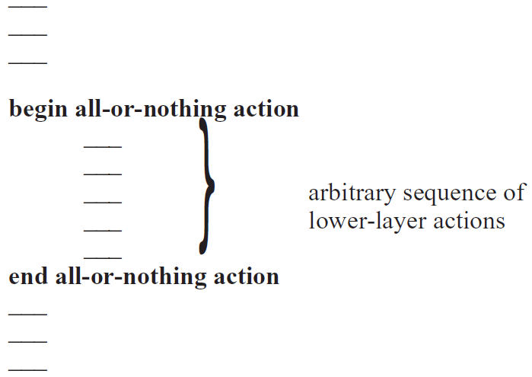
Atomicity

Slide 13
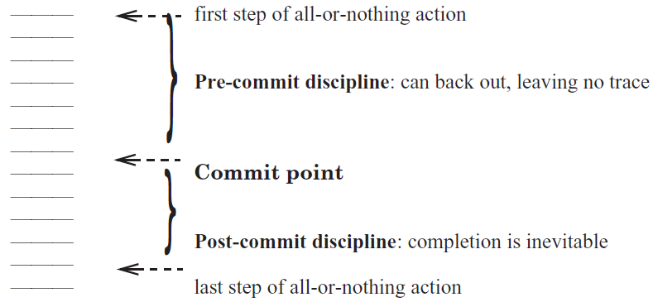
Commit
不可避免的

Slide 14
Commit
Pre-commit
  identify all the resources needed to complete the all-or-nothing action,
  establish their availability
  maintain the ability to abort at any instant
    shared resources, once reserved, cannot be released until the commit point is passed
    should not do anything externally visible：当此时别的用户查询记录的，应该还看不见新数据
Post-commit
  release reserved resources that are no longer needed
  perform externally visible actions
  CANNOT try to acquire additional resources
Q: where’s commit in ALL_OR_NOTHING_PUT?
Notes:
should not do anything externally visible：当别的用户查询记录的时候应该还看不见新数据

Slide 15
Shadow Copy
Pre-commit:
  Create a complete duplicate working copy of the file that is to be modified
  make all changes to the working copy
Commit point:
  Carefully exchange the working copy with the original
  Typically this step is bootstrapped
Post-commit:
  Release the space that was occupied by the original
The golden rule of atomicity
  Never modify the only copy! ：如果只有一个副本，那么就不要直接修改这个单一的副本
Notes:
如果只有一个副本，那么就不要直接修改这个单一的副本

Slide 16
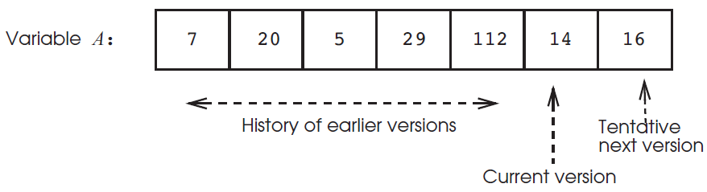
Journal Storage
a store operation
  Not overwrites old data
  create a new, tentative version of the data
    remains invisible to any reader outside this all-or-nothing action
    until the action commits
一个记录A：
读取的时候，从右往左找到最后一个被提交的版本来读取，如果某个数据写了之后被abort就会加上pending或者abort，然后读取的时候就不会读它。
Notes:
读取的时候，从右往左找到最后一个被提交的版本来读取

Slide 17
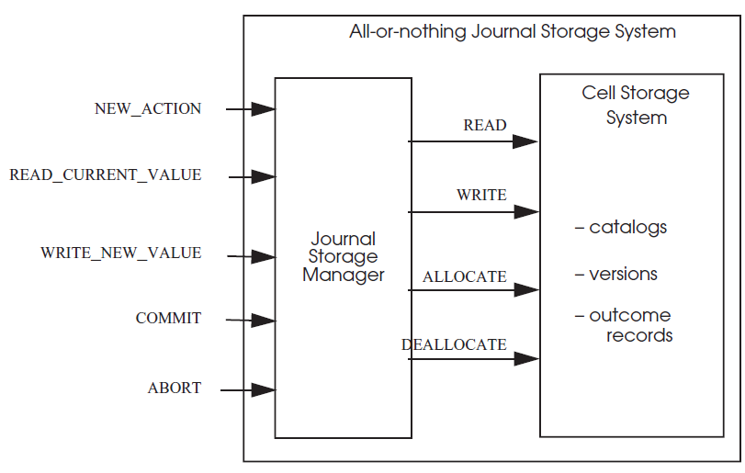
Journal Storage
Cell storage system是原始的没有容错能力的
Notes:
Cell storage是原始的没有容错能力的

Slide 18
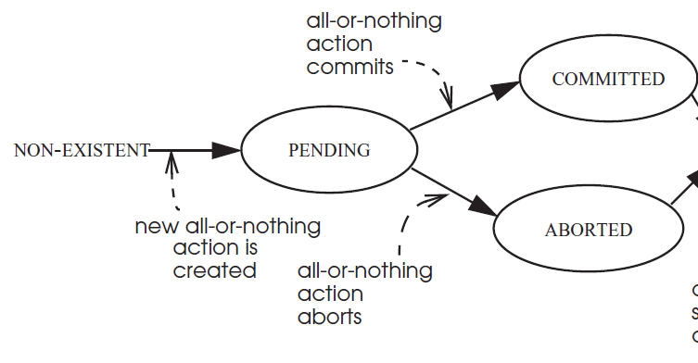
Journal Storage

Slide 19
Journal Storage
procedure NEW_ACTION ()
id ← NEW_OUTCOME_RECORD ()
id.outcome_record.state ← PENDING
return id
procedure COMMIT (reference id)
id.outcome_record.state ← COMMITTED
procedure ABORT (reference id)
id.outcome_record.state ← ABORTED
找到id对应的副本空间，修改其状态为pending

Slide 20
Journal Storage
procedure READ_CURRENT_VALUE (data_id, caller_id)
starting at end of data_id repeat until beginning
v ← previous version of data_id // Get next older version
a ← v.action_id // Identify the action a that created it
s ← a.outcome_record.state // Check action a’s outcome record
if s = COMMITTED then
return v.value
else skip v // 表明变量还没被写过Continue backward search
signal (“Tried to read an uninitialized variable!”)
这个函数找到最新的且commit的版本并读取
这里传入的caller_id实际上是内部检查，确保有个事务是在进行read，防止一些非法的调用。

Slide 21
Journal Storage
procedure WRITE_NEW_VALUE (reference data_id, new_value, caller_id)
if caller_id.outcome_record.state = PENDING
append new version v to data_id
v.value ← new_value
v.action_id ← caller_id
else signal (“Tried to write outside of an all-or-nothing action!”)
11行表示这个caller_id事务处于pending状态，而不是说有数据处于pending状态此时就可以增加新的数据

Slide 22
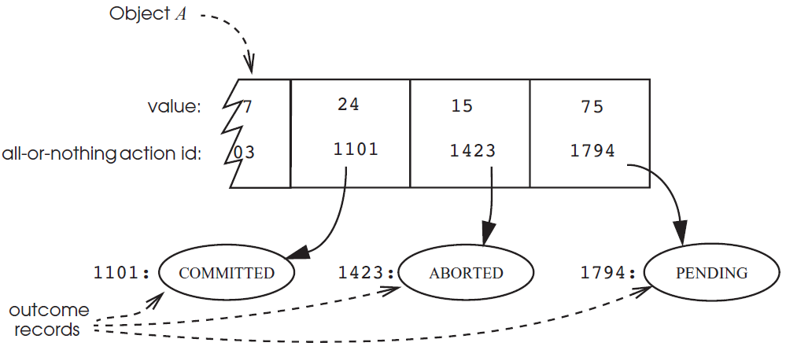
Journal Storage
优点：①创建新版本在log里面很快
②多个版本冲突的概率比较低，很少需要判断冲突并处理。
基础版本
创建版本1
创建版本2
Action id就是caller id
TIPS:如果事务1423和1794先都不知道最后会abort,如果两者都先读24再操作写回，那么就不对。此时如果两者都基于24操作，那么两者有一个不能commit。
Notes:
如果有多个并行事务写objectA，你们它后台有内部机制要加锁，从而防止几个并行事务的执行没有约束。

Slide 23
Journal Storage
procedure TRANSFER (reference debit_account, reference credit_account, amount)
my_id ← NEW_ACTION ()
xvalue ← READ_CURRENT_VALUE (debit_account, my_id)
xvalue ← xvalue - amount
WRITE_NEW_VALUE (debit_account, xvalue, my_id)
yvalue ← READ_CURRENT_VALUE (credit_account, my_id)
yvalue ← yvalue + amount
WRITE_NEW_VALUE (credit_account, yvalue, my_id)
if xvalue > 0 then
COMMIT (my_id)
else
ABORT (my_id)
signal (“Negative transfers are not allowed.”)
转账程序
给个事务id号
如果转账金额大于0

Slide 24
Log
The application
  first logs the change in journal storage
  then it installs the change in cell storage
separates the reading and writing of data from the failure recovery mechanism
Minimize the number of storage accesses required for the most common activities
  Reads, updates
Rarely-performed activities may not be minimal
  failure recovery

Slide 25
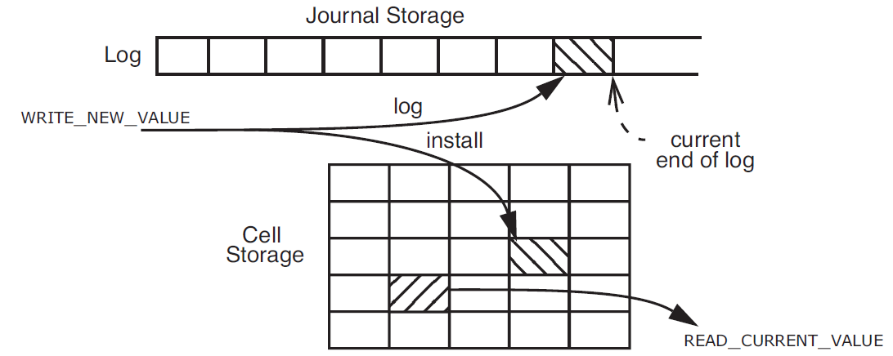
Log
·用log日志，来记录你要write修改什么。在commit之前，先把要做的事情写到log里面，然后commit之后再写入cell storage。
·如果写入cell storage坏掉了，下一次启动，就会记录写坏了，就可以根据log恢复到正常状态。
Log里面存着旧值和新值两个值
Write-ahead-log protocol (WAL)
  Log the update before installing it
在写数据库之前要先写log。
从log恢复数据效率比较低，但是因为出错不常出现，所以没关系

Slide 26
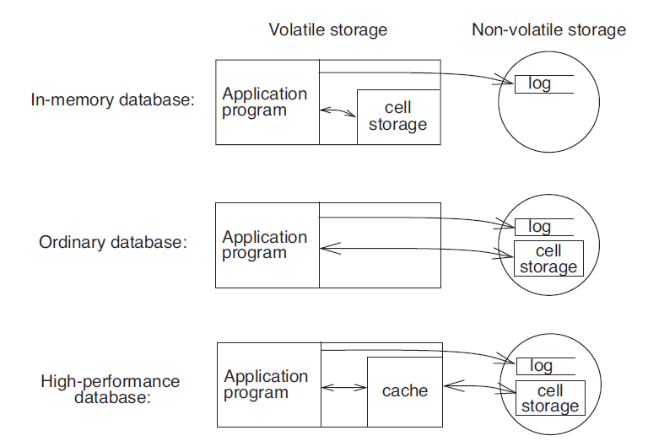
Log
三种数据库解决方案
断电后的恢复就根据log把所有事情做一遍，比较慢。
硬盘上只有log
无缓冲的基于硬盘的数据库。任何对数据库的更新都被放与cell storage。那么更加需要老的值以便回退。
第三种解决方案-常见（要掌握）
Log要是不会丢数据的

Slide 27
Logging Protocol
Redo和undo都写在log里面
CHANGE Record
  The identity of the all-or-nothing action
  （1）A component action redo（redo value-新的值）
    installs the intended value in cell storage
      After commit, if the system crashes , the recovery procedure can perform the install on behalf of the action
  （2）A second component action undo（undo value-旧值）
    reverses the effect on cell storage of the install
      After aborts or the system crashes, it may be necessary for the recovery procedure to reverse the effect

Slide 28
Logging Protocol
The application
NEW_ACTION
  log a BEGIN record that contains just the new identity
  As the all-or-nothing action proceeds through its pre-commit phase, it logs CHANGE records
To implement COMMIT or ABORT
  logs an OUTCOME record
  commit point

Slide 29
Logging Protocol
procedure TRANSFER (debit_account, credit_account, amount)
my_id ← LOG (BEGIN_TRANSACTION)
dbvalue.old ← GET (debit_account)
dbvalue.new ← dbvalue.old - amount
crvalue.old ← GET (credit_account, my_id)
crvalue.new ← crvalue.old + amount
LOG (CHANGE, my_id,
“PUT (debit_account, dbvalue.new)”, //redo action
“PUT (debit_account, dbvalue.old)” ) //undo action
读取数据库内旧数据
写个log-对debit账户

Slide 30
Logging Protocol ---transfer (cont.)
写log-对credit账户
LOG ( CHANGE, my_id,
“PUT (credit_account, crvalue.new)” //redo action
“PUT (credit_account, crvalue.old)” ) //undo action
PUT (debit_account, dbvalue.new) // install
PUT (credit_account, crvalue.new) // install
if dbvalue.new > 0 then
LOG ( OUTCOME, COMMIT, my_id)
else
LOG (OUTCOME, ABORT, my_id)
signal(“Action not allowed. Would make debit account negative.”)
LOG (END_TRANSACTION, my_id)
此时数据就不会丢失了
Install这里表示写如数据库

Slide 31
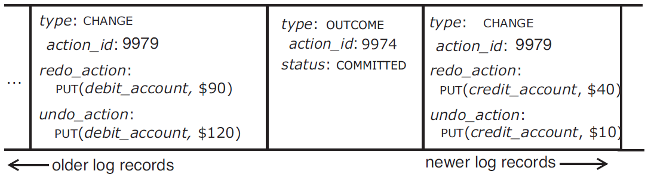
Logging Protocol
type:这条log记录是做什么 如change
如上面第一个是吧事务为9979的值改成120改成90。如果中途宕机，那么可以恢复为原来值。或者后面将change commit的，那么就要把它加入。
log要保证不会丢，所以log不能缓冲，直接写入硬盘。硬盘会坏--就用高可靠的硬盘。
Notes:
write behave Log

Slide 32
Logging Protocol
针对第一种数据库，In-memory database
procedure ABORT (action_id) 传入特定的事务id
starting at end of log repeat until beginning
log_record ← previous record of log
if log_record.id = action_id then 找到该事务相关的log
if (log_record.type = OUTCOME) 如果已经有结论了就不应该abort，所以给个错误。
then signal (“Can’t abort an already completed action.”)
if (log_record.type = CHANGE)如果在changer就用undo内容写回去。
then perform undo_action of log_record
if (log_record.type = BEGIN)找到头了，说明没有这个log
then break repeat
LOG (action_id, OUTCOME, ABORTED) // 加入个outcome类型的log
LOG (action_id, END)

Slide 33
Logging Protocol: in-memory database
procedure RECOVER () // Recovery procedure for a volatile, in-memory database.
winners ← NULL
starting at end of log repeat until beginning
log_record ← previous record of log
if (log_record.type = OUTCOME)
then winners ← winners + log_record // Set addition.
starting at beginning of log repeat until end
log_record ← next record of log
if (log_record.type= CHANGE)
and (outcome_record ← find (log_record.action_id) in winners)
and (outcome_record.status = COMMITTED) then
perform log_record.redo_action
recovery的过程：从后往前扫寻找那些outcome的并且是commit的那些log形成一个集合。然后从前往后扫，找到属于前面集合中的change，然后进行redo。

Slide 34
Soft state -写在内存（缓存）中的那些
  Can be discarded, no need to redo，能够丢，但是也能恢复
Crash during recovery (volitile cell )

Slide 35


Slide 36
Non-volatile logging
第二类数据库，硬盘数据库-每个操作都会有持久影响
NEW_ACTION 111
CHANGE 111
  New A→ old A
CHANGE 111
  New B -> old B
  ( some install )
OUTCOME 111
  COMMIT
  ( some install )
END 111
不确定写了什么-就随意执行了点东西

Slide 37
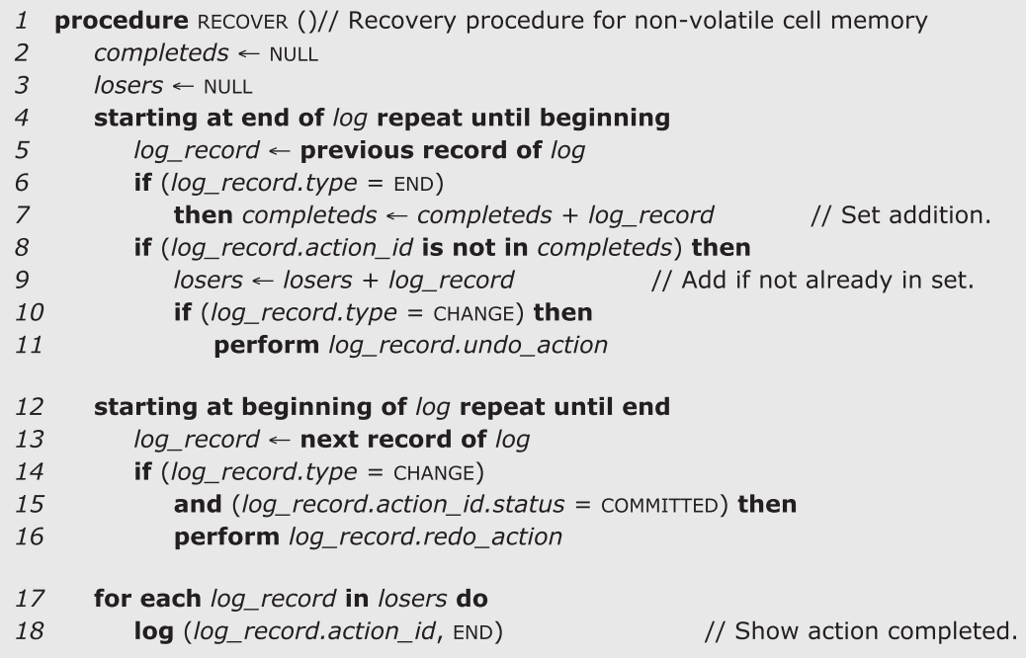


Logging Protocol: non-volatile cell memory
Necessary ?
减少以后再看end的事务

Slide 38

NEW_ACTION 114
CHANGE 114
  New A→ old A
  New B -> old B
  ( install the cell )
OUTCOME 114
  COMMIT
END 114
在change和outcome之间崩溃，recovery时候undo。
万一这里commit与end之间崩溃就recovery时候什么都不做，只是加个end。
万一这里abort与end之间崩溃就recovery时候undo，再end。
如果end后崩溃，那么就不用管他。

Slide 39
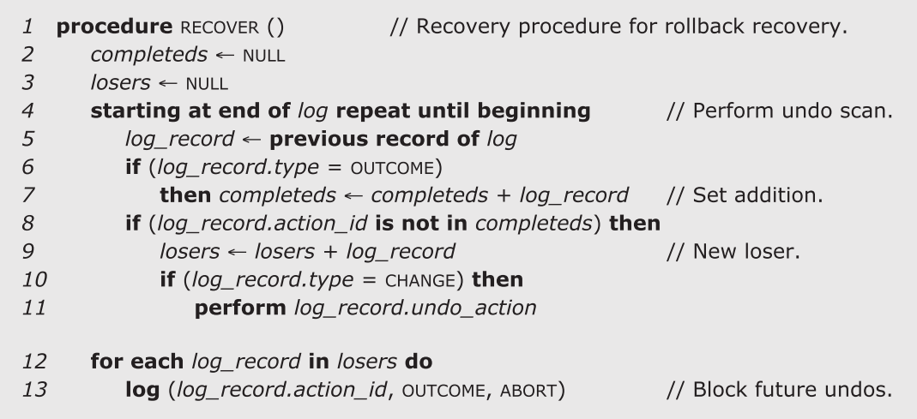
Undo logging Logging Protocol: non-volatile cell memory
这里应该是outcome.commit

Slide 40

NEW_ACTION 114
CHANGE 114
  New A→ old A
  New B -> old B
OUTCOME 114
  COMMIT
  ( install the cell )
END 114
这里崩溃，由于没有commit，那么什么都不做。
如outcome且commit这里崩溃，就redo
如outcome且abort崩溃，recovery的时候不用干事情，就加个end。因为还没install

Slide 41
redo logging
procedure RECOVER()
completeds - null
losers=null
starting at the end of log repeat until begin
  log_record = previous record of log
  if(log_record_type == end)
    then completeds = completeds + log_record
  if( log_record.action_id is not in completeds)
    loser = loser+log_record
    if(log_record_type == outcome )
    perform log_record.redo_action
    for each log_record in losers do
    log(log_record.action_id,OUTCOME,COMMIT)

Slide 42
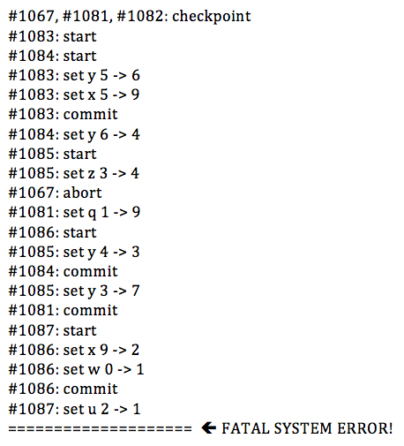

Slide 43
winners: 1067, 1081, 1084, 1083, and 1086
losers: 1082, 1085, and 1087

